Slide 1
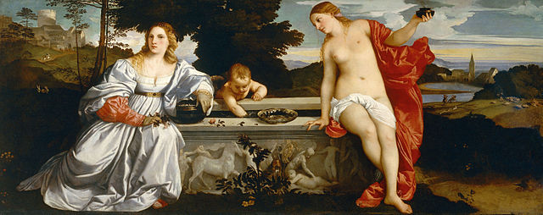
History 336
Ideas and Society in Early Modern Europe:
The Debate about Gender and Identity

Slide 2
Who was Gabrielle Suchon (1632-1703)?
a scrap of information thanks to Abbé Philibert Papillon (1745) (p. 15)
from the robe nobility
into the convent…and out by 1673
On Voluntary Celibacy or Life without Commitments (1700)
education: autodidact, books?

Slide 3
Who was Gabrielle Suchon (1632-1703)?
“a third way” for women (p. 3), “Neutralist” (p. 26)
advice: charitable work, no talking to men, reliance on God
“Suchon is the only female writer of her time to have had no male protector, supporter, or interlocutor” (p. 28).

Slide 4
Who was Gabrielle Suchon (1632-1703)?
Women and philosophy
moral philosophy
no help from Stoicism
Scepticism
Gilles Ménage History of Woman Philosophers (1690)
Louis de Lesclashe: philosophy “could lead to doubt and impiety in women” (p. 34)
Suchon: women should study and come together to discuss philosophy
Elsa Dorlin, “logical feminism” (p. 40)

Slide 5
Some themes in Suchon’s writings
Treatise on Ethics and Politics (1693)
Voluntary Celibacy or Life without Commitments (1700)
Freedom
deprivations (p. 2)
“third way” -- philosophy
Sources
classical , Christian, modern
strategy

Slide 6
Two more sources
Jean-Baptiste Poquelin = Molière, The Learned Women (1672)
misogyny and educated women
Denis Diderot, The Nun (1760 / 1796)

Slide 7
Questions to consider for the rest of the course
What passages strike you as historically significant? Mark them and write them down.
What positions on women and gender does a given primary source take on women and gender? How does the author support these positions?
Can you formulate at least one historical question based on the assigned reading to start a larger discussion?
Can you find a few secondary sources (and other primary sources) by using the library catalogue and databases that will help you answer your historical question?
Can you think of any current news stories that relate to women and gender?

Slide 8
In the news
“Dean Janet Henderson makes Llandaff Cathedral history,” BBC, 2 March 2013 http://www.bbc.co.uk/news/uk-wales-south-east-wales-21618233

Slide 9
Annotated bibliography
How did Peter Canisius SJ edit the letters of the Church Father, St. Jerome?
Lössl, Josef. “Konfessionelle Theologie und humanistisches Erbe: zur Hieronymus-briefedition des Petrus Canisius.” In Petrus Canisius SJ (1521-1597): Humanist und Europäer, edited by Rainer Berndt, 121-50. Berlin: Akademie Verlag, 2000.
Lössl argues that Canisius’ edition of St. Jerome is more a product of humanist editorial traditions than of confessional polemics of the Reformation era. He states that Canisius followed the editorial principles of Erasmus, the great humanist editor of Jerome.

Slide 10
Annotated Bibliography
Rice, Eugene F., Jr. Saint Jerome in the Renaissance. Baltimore: Johns Hopkins University Press, 1985.
Rice’s book remains the authoritative study of the reception of Jerome in the period 1400-1600. Chapter 6, “Between Protestants and Catholics,” mentions Canisius in the context of the Catholic effort to use Jerome as support for Catholic doctrine and devotion in the sixteenth century.

